Slide 1
Nonequilibrium quantum effects
Seminar Talk
Simulating the Lindblad equation
Maxim Root
Institute for Theoretical Physics II: Soft Matter
Düsseldorf, 26.05.2025

Slide 2
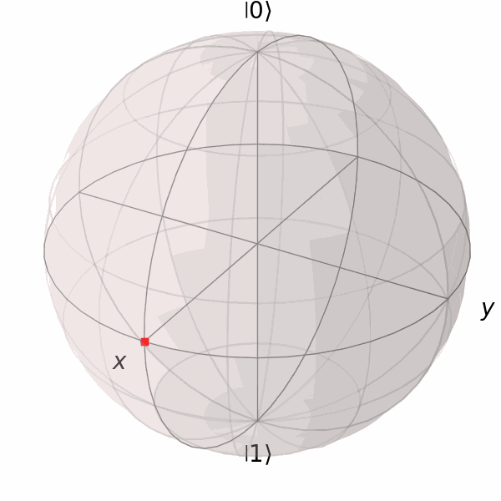
Contents
1) Lindblad equation
2) Approximations
3) Introduction to Qutip
4) Examples
spin (two-level) system
spin-chain
fermionic chain
5) Limits of Qutip
6) Summary

Slide 3
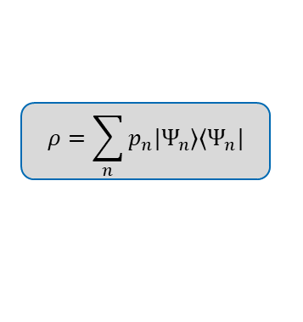
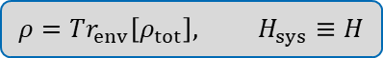
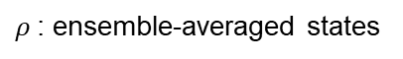
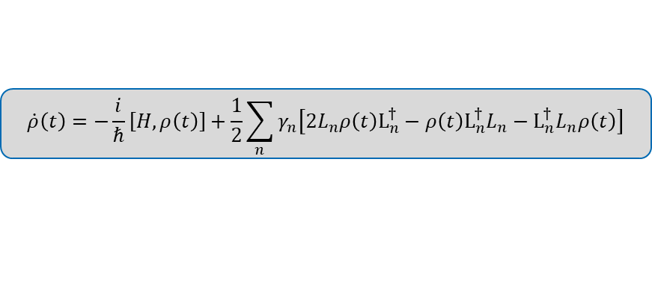
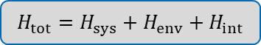
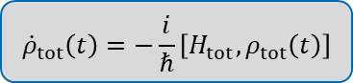
1) Lindblad Equation
open system quantum dynamics environment introduces stochastic processes
density matrix
Hamiltonian
system & environment
$$ρ=\sum_{n}{p_{n}|Ψ_{n}⟩⟨Ψ_{n}|}$$
$$H_{tot}=H_{sys}+H_{env}+H_{int}$$
$${\dot{ρ}}_{tot}\left(t\right)=−\frac{i}{ℏ}\left[H_{tot},ρ_{tot}\left(t\right)\right]$$
Trace out environment:
$$ρ=Tr_{env}\left[ρ_{tot}\right], H_{sys}≡H$$
$ρ$: ensemble-averaged states
approximations
Jump operators
$$\dot{ρ}\left(t\right)=−\frac{i}{ℏ}\left[H,ρ\left(t\right)\right]+\frac{1}{2}\sum_{n}{γ_{n}\left[2L_{n}ρ\left(t\right)L_{n}^{†}−ρ\left(t\right)L_{n}^{†}L_{n}−L_{n}^{†}L_{n}ρ\left(t\right)\right]}$$
trace-preserving
completely positive
Lindbladian

Slide 4
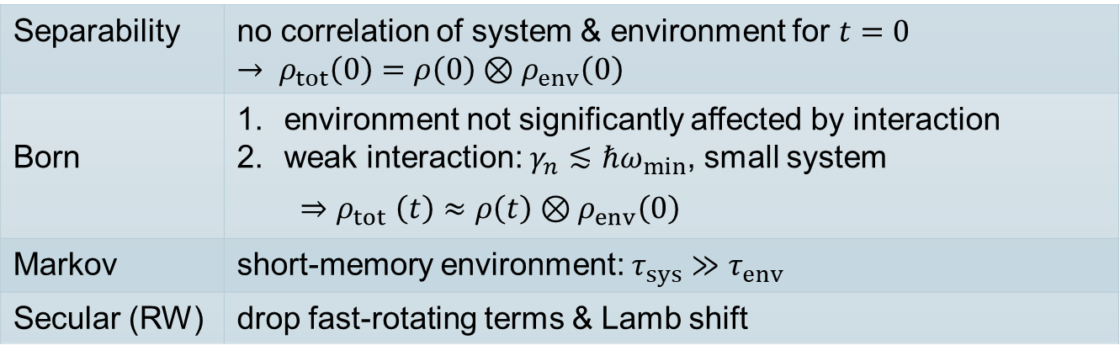
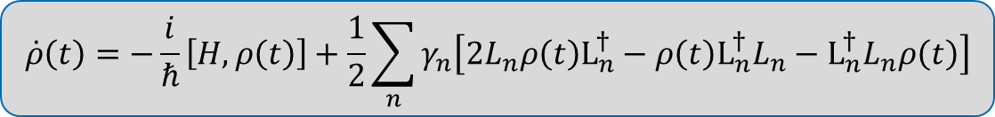
2) Approximations
$$\dot{ρ}\left(t\right)=−\frac{i}{ℏ}\left[H,ρ\left(t\right)\right]+\frac{1}{2}\sum_{n}{γ_{n}\left[2L_{n}ρ\left(t\right)L_{n}^{†}−ρ\left(t\right)L_{n}^{†}L_{n}−L_{n}^{†}L_{n}ρ\left(t\right)\right]}$$
Separability | no correlation of system & environment for $t=0$ $$→ ρ_{tot}\left(0\right)=ρ\left(0\right)⊗ρ_{env}\left(0\right)$$
Born | environment not significantly affected by interaction weak interaction: $γ_{n}≲ℏω_{min}$, small system $${⇒ρ}_{tot}\left(t\right)≈ρ\left(t\right)⊗ρ_{env}\left(0\right)$$
Markov | short-memory environment: $τ_{sys}≫τ_{env}$
Secular (RW) | drop fast-rotating terms & Lamb shift

Slide 5
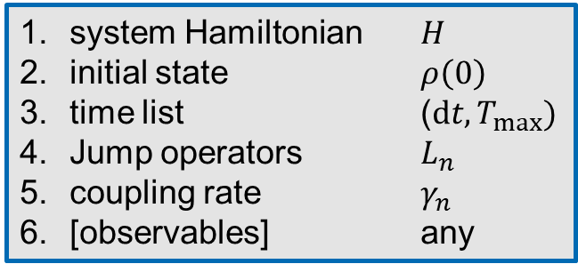
3) Introduction to Qutip
$$\dot{ρ}\left(t\right)=−\frac{i}{ℏ}\left[H,ρ\left(t\right)\right]+\frac{1}{2}\sum_{n}{γ_{n}\left[2L_{n}ρ\left(t\right)L_{n}^{†}−ρ\left(t\right)L_{n}^{†}L_{n}−L_{n}^{†}L_{n}ρ\left(t\right)\right]}$$
system Hamiltonian $H$
initial state $ρ\left(0\right)$
time list ($dt, T_{max})$
Jump operators $L_{n}$
coupling rate $γ_{n}$
[observables] any
observables
mesolve

Slide 6
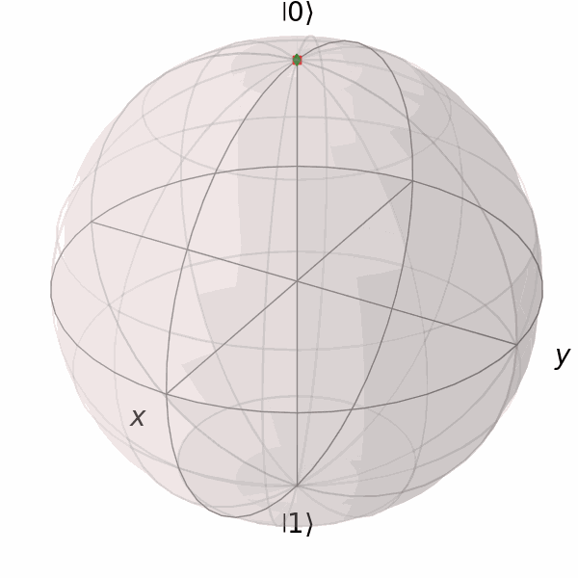
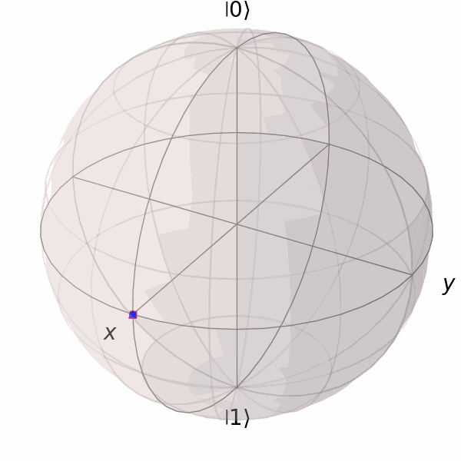
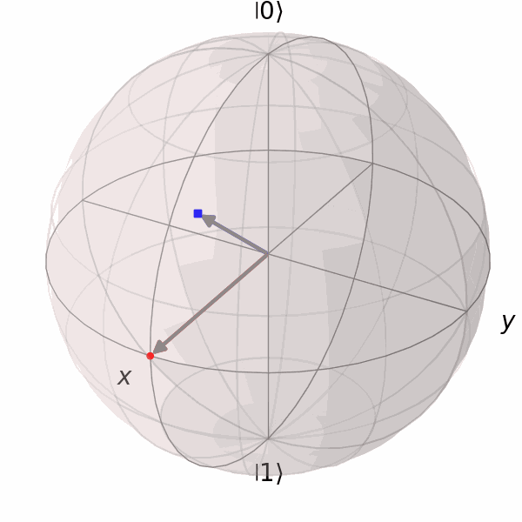
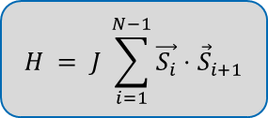
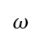
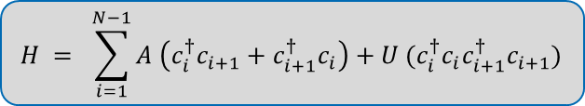
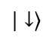
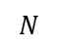
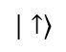
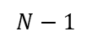
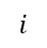
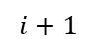
4) Examples – Overview
single body system
many body systems
two-level system
.......
.......
...
...
$$|↑⟩$$
cooling
decoherence
purity
1
2
3
$$i$$
$$i+1$$
$$N−1$$
$$N$$
$$ω$$
spin chain
$$|↓⟩$$
$$H = J \sum_{i=1}^{N−1}{\vec{S_{i}}⋅{\vec{S}}_{i+1}}$$
dynamics on Bloch sphere
fermionic chain
$$H = \sum_{i=1}^{N−1}{A \left(c_{i}^{†}c_{i+1}+c_{i+1}^{†}c_{i}\right)+U (c_{i}^{†}c_{i}c_{i+1}^{†}c_{i+1})}$$

Slide 7
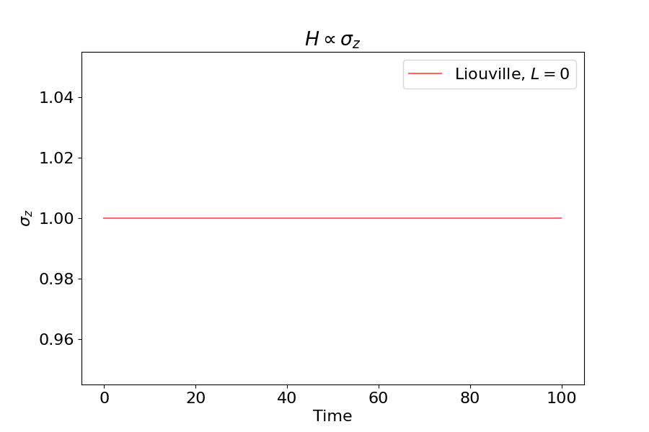
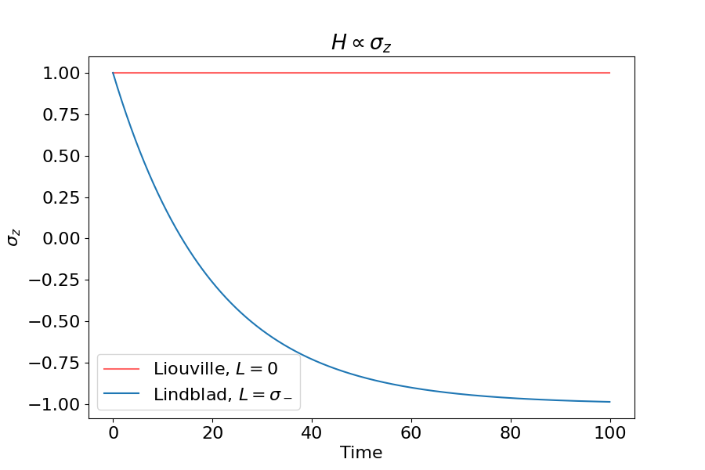
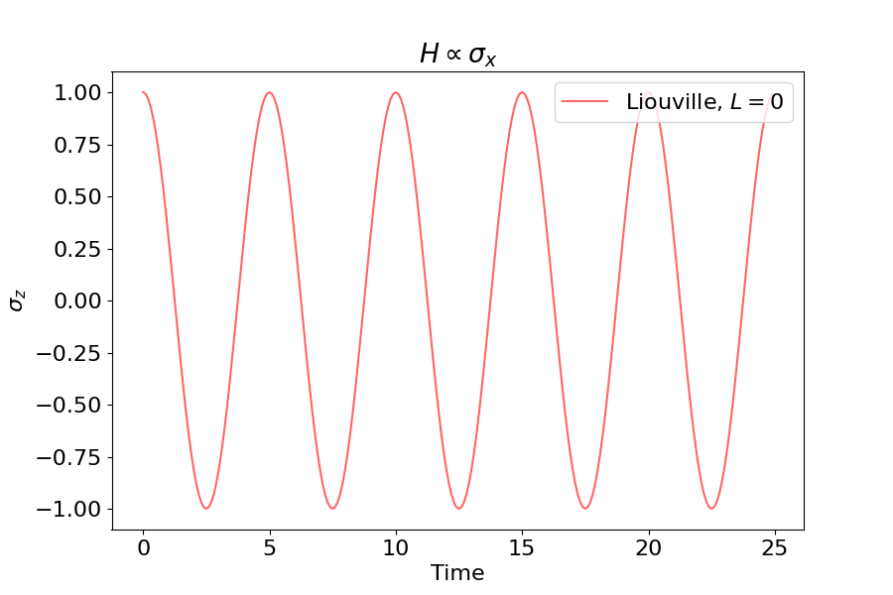
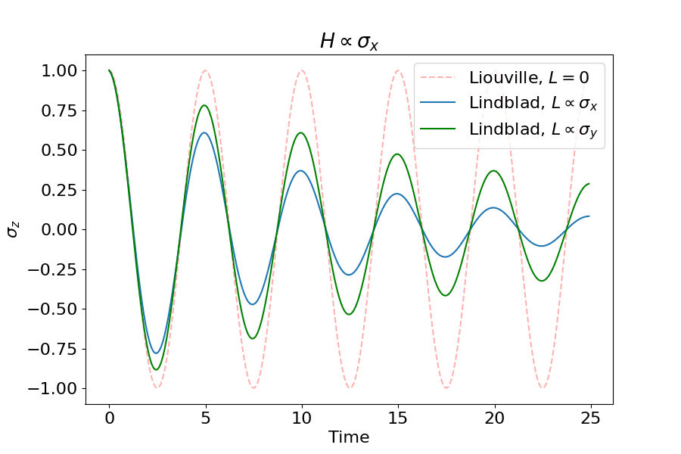
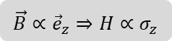
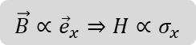
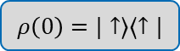
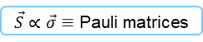
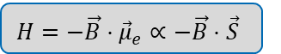
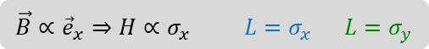
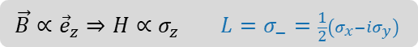
4) Examples – spin (two-level) system
$$H=−\vec{B}⋅{\vec{μ}}_{e}∝−\vec{B}⋅\vec{S}$$
$$ρ\left(0\right)=|↑⟩⟨↑|$$
$$|↑⟩$$
$$ω$$
magnetic field
magnetic moment
$\vec{S}∝\vec{σ}≡$ Pauli matrices
$$|↓⟩$$
$$\vec{B}∝{\vec{e}}_{z}⇒H∝σ_{z}$$
$$\vec{B}∝{\vec{e}}_{z}⇒H∝σ_{z} L=σ_{−}=\frac{1}{2}\left(σ_{x}−iσ_{y}\right)$$
$$\vec{B}∝{\vec{e}}_{x}⇒H∝σ_{x} L=σ_{x} L=σ_{y}$$
$$\vec{B}∝{\vec{e}}_{x}⇒H∝σ_{x}$$

Slide 8
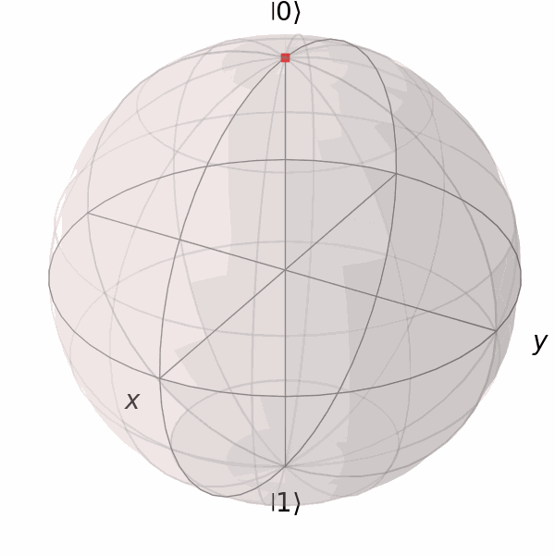
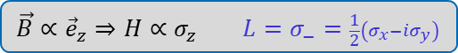
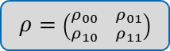
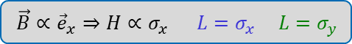
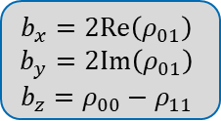
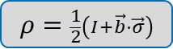


4) Examples – spin (two-level) system
$$\vec{B}∝{\vec{e}}_{z}⇒H∝σ_{z} L=σ_{−}=\frac{1}{2}\left(σ_{x}−iσ_{y}\right)$$
$$ρ=\frac{1}{2}\left(I+\vec{b}⋅\vec{σ}\right)$$
$\vec{B}∝{\vec{e}}_{x}⇒H∝σ_{x} L=σ_{x}$ $L=σ_{y}$
Bloch vector
$$b_{x}=2Re\left(ρ_{01}\right)$$
$$b_{y}=2Im\left(ρ_{01}\right)$$
$$b_{z}=ρ_{00}−ρ_{11}$$
$$H$$
$$ρ=\left(\begin{matrix}ρ_{00} & ρ_{01} \\ ρ_{10} & ρ_{11}\end{matrix}\right)$$
dissipation
dephasing
$$H$$

Slide 9

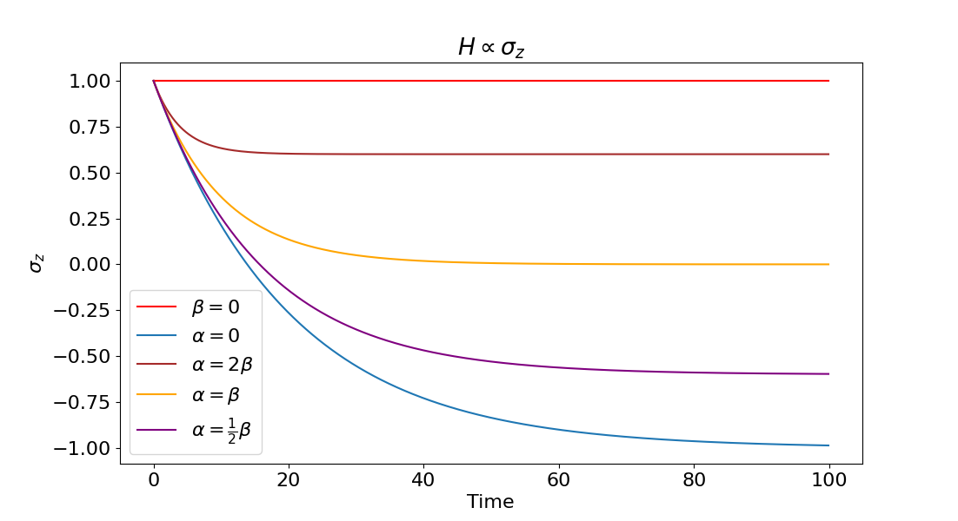
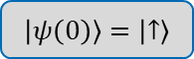
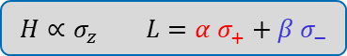
4) Examples – spin (two-level) system
$$H∝σ_{z} L={α σ}_{+}+β σ_{−}$$
introduces a competing process
$$\left|ψ\left(0\right)\right\rangle =\left|↑\right\rangle$$
$$H$$

Slide 10
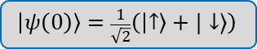
4) Examples – spin (two-level) system
$$H∝σ_{z} L={α σ}_{+}+β σ_{−}$$
introduces a competing process
$$\left|ψ\left(0\right)\right\rangle =\frac{1}{\sqrt{2}}\left(\left|↑\right\rangle +|↓⟩\right)$$
$$H$$

Slide 11
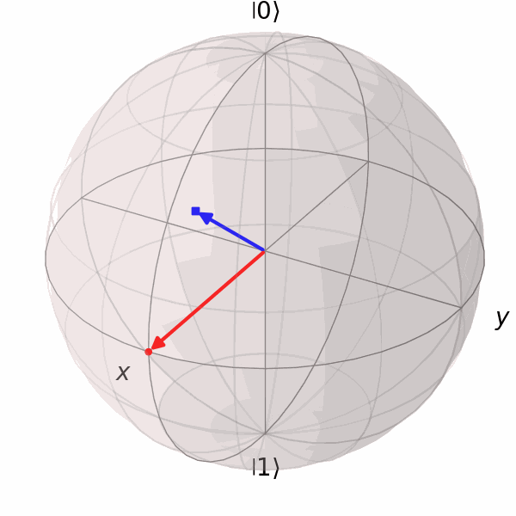


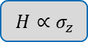
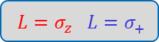
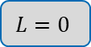
4) Examples – spin (two-level) system
Hamiltonian maintains purity (non-purity)
Jump operators can destroy (restore) purity
$$H∝σ_{z}$$
$$H$$
thermal bath
$$H$$
dephasing
pure dephasing
$$L=0$$
$$L=σ_{z} L=σ_{+}$$

Slide 12


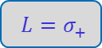
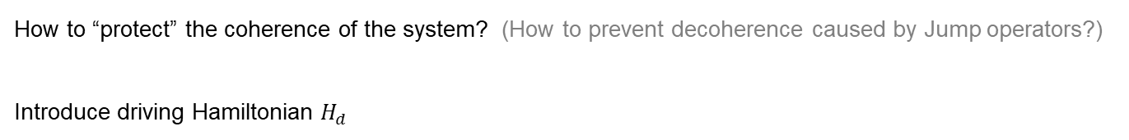
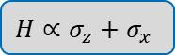



4) Examples – spin (two-level) system
How to “protect” the coherence of the system? (How to prevent decoherence caused by Jump operators?)
Introduce driving Hamiltonian $H_{d}$
protects System from decoherence
$$H_{0}∝σ_{z}$$
$$H_{d}∝σ_{x}$$
$$H_{0}$$
$$H_{0}$$
$$H∝σ_{z}+σ_{x}$$
$$L=σ_{+}$$

Slide 13







4) Examples – spin chain
coupling
$$H = J \sum_{i=1}^{N−1}{\vec{S_{i}}⋅{\vec{S}}_{i+1}} = J \sum_{i=1}^{N−1}{( S_{i}^{x}S_{i+1}^{x} + S_{i}^{y}S_{i+1}^{y} + S_{i}^{z}S_{i+1}^{z}) }$$
$J<0$: ferromagnetic
$J>0$: anti-ferromagnetic
N=3
$$ρ\left(0\right)=|↑↓↓⟩⟨↑↓↓|$$
State probability
$$\left(L_{1,i}=σ^{+}σ^{−}\right)$$
$$L_{2,i}=σ^{−}$$
$$H_{↓}∝σ_{i}^{z}$$
000
001
010
011
100
101
110
111
Fock number

Slide 14





4) Examples – fermionic chain
hopping amplitude
interaction strength
$$H = \sum_{i=1}^{N−1}{A \left(c_{i}^{†}c_{i+1}+c_{i+1}^{†}c_{i}\right)+U (c_{i}^{†}c_{i}c_{i+1}^{†}c_{i+1})}$$
$$\left\{c_{i}{ , c}_{j}^{†}\right\}=δ_{ij}$$
$$\left\{c_{i ,}c_{j}\right\}=0=\left\{c_{i}^{†}{, c}_{j}^{†}\right\}$$
hop left
hop right
neighbors only
.......
.......
$$L_{1}=c_{1}^{†}$$
$$L_{N}=c_{N}$$
0 else
...
...
$$ρ\left(0\right)=|0⟩⟨0|$$
1
2
3
$$i$$
$$i+1$$
$$N−1$$
$$N$$

Slide 15





4) Examples – fermionic chain
$$H = \sum_{i=1}^{N}{A \left(c_{i}^{†}c_{i+1}+c_{i+1}^{†}c_{i}\right)+U (c_{i}^{†}c_{i}c_{i+1}^{†}c_{i+1})}$$
$$L_{1}=c_{1}^{†}$$
$$L_{N}=c_{N}$$
0 else
$$ρ\left(0\right)=|0⟩⟨0|$$
.......
.......
...
...
1
2
3
$$i$$
$$i+1$$
$$N−1$$
$$N$$
N=8
N=3
State probability
000
001
010
011
100
101
110
111
Fock number

Slide 16






4) Examples – fermionic chain
.......
.......
$$I_{in}$$
...
...
$$I_{out }$$
1
2
3
$$i$$
$$i+1$$
$$N−1$$
$$N$$

Slide 17





5) Limits of Qutip
Hilbert space dimension:
$$d×d$$
simulation time grows exponentially with number of quanta
hard to simulate many body systems efficiently
simulation time grows with $d$
hard to simulate many states efficiently
closed, pure
open
need to find work-arounds for complex / large systems
no interactions & linear $L_{i}$ $→$ C-matrix
reduce Hilbert space
find symmetries $→$ eliminate degrees of freedom
cut off (almost) inaccessible states
approximate further
Qubits | $$d$$ | $$d^{2}$$ | $$d^{3}$$ | Sim. time
$$4$$ | $$2^{4}$$ | $$2^{8}$$ | $$2^{12}$$ | very fast
$$6$$ | $$2^{6}$$ | $$2^{12}$$ | $$2^{18}$$ | fast
$$8$$ | $$2^{8}$$ | $$2^{16}$$ | $$2^{24}$$ | ok
$$10$$ | $$2^{10}$$ | $$2^{20}$$ | $$2^{30}$$ | slow
$>10$Qubits $→$ painful

Slide 18
6) Summary
Qutip is powerful in its tools but limited in performance
great for analysis of open quantum systems
visualization via Bloch sphere, other plots
complex / large systems require work-arounds (or a lot of time)

